Slide 1
DESIGN AND DEVELOPMENT OF AN ANDROID APP
FOR
ADVANCED HEALTH MANAGEMENT SYSTEM
Name | ID
Md. Delwar Hossain | 131-15-2352
Fahmida Khanam | 131-15-2363
Sanjida Javeen | 131-15-2318
Nazmun Nessa Moon
Assistant Professor
Department of CSE
Daffodil International University
Thursday 15 December 2016

Slide 2
Overview
Introduction
Objective
Benefits
Implementation
Implementation tools and software
Use Case Model
Data Flow Diagram
ER Diagram
Video Presentation
Limitations
Future Work
Conclusion
References

Slide 3
Introduction
Diet Chart management
Vaccination management
Doctor Management,
Medical History management
Emergency Call
Emergency Note

Slide 4
Objective
Checking regular health information.
Reminding the medicine / food order.
Saving all information into my database.
Connecting with doctors etc.
.

Slide 5
Benefits
Proper Caring a family.
Time consuming.
Schedule maintaining of diet/medicine/doctors appointment in time.
Emergency call
Vaccination info
Alert System

Slide 6
Implementation
User friendly interface
Huge database implementation
Creating profile for every patient
Link Up every patient info with id.
Adding Updated android apps features.

Slide 7
Implementation Tools & Software
Android studio.
JDK update version.
SQLiteDatabase
OS is Independent .
Min 4GB Ram is needed.
SDK Tools.
Emulator/Android Devices.

Slide 8
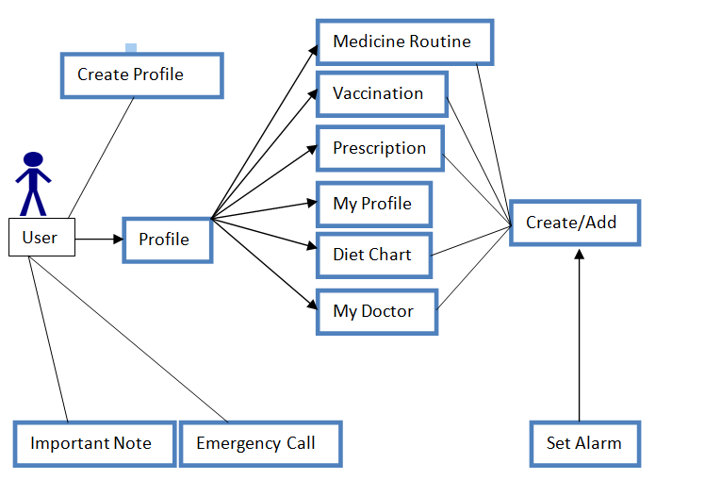
Use Case Model

Slide 9
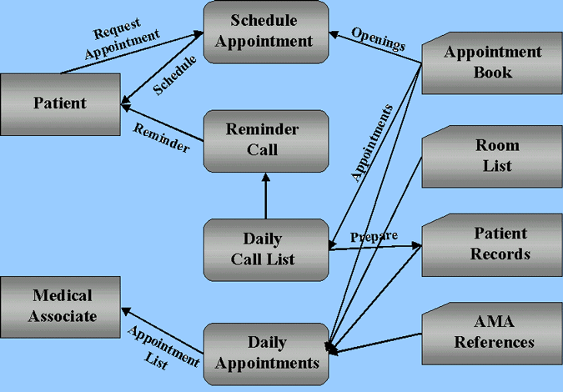
Data Flow Diagram

Slide 10
Limitations
Completed this application in the local.
Entire design and framework has been very hard to remind.
Costly in future implementation.

Slide 11
Future Work
Make the system more dynamic and secured.
Convert all of the data and information in online server.
Stored all in the information into web server.

Slide 12
CONCLUSION
Learning while developing was the main theme of this project. This project helps us to care all the family members health information anywhere I stayed. We try to develop a smart way to care a family by smart phone. Now everything is going on digital way. That’s why we try to develop this apps to care health by digital way.

Slide 13


